Slide 1
Our paperless pickup and delivery system
Visit our Website
www.jandklogistics.ca

Slide 2
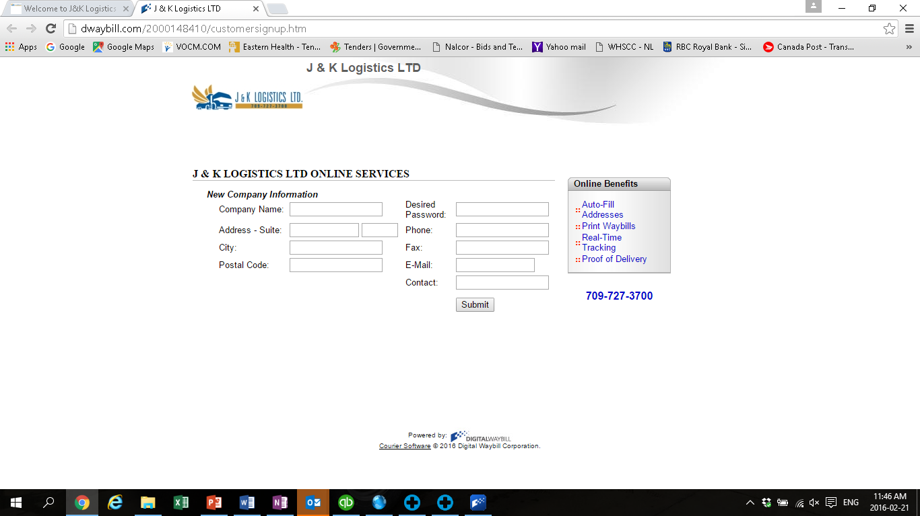
Complete your company information.
You (or the persons email you enter) will receive an email to approve the set up.
Then they will receive a return email from jandklogisitics.ca asking you to download our software.

Slide 3
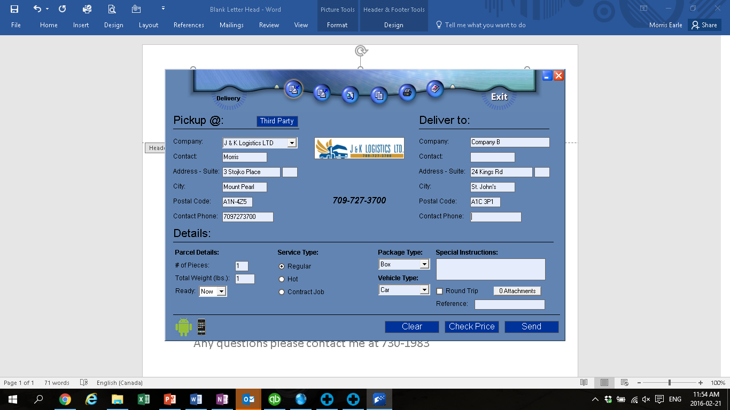
Once software is downloaded you can then log in.
This is your entry screen. All information entered will be saved, and the next time you ship all information is auto filled.
You can check rates and/or place the call (send).
If you want a paper waybill for your records, you can print too.

Slide 4
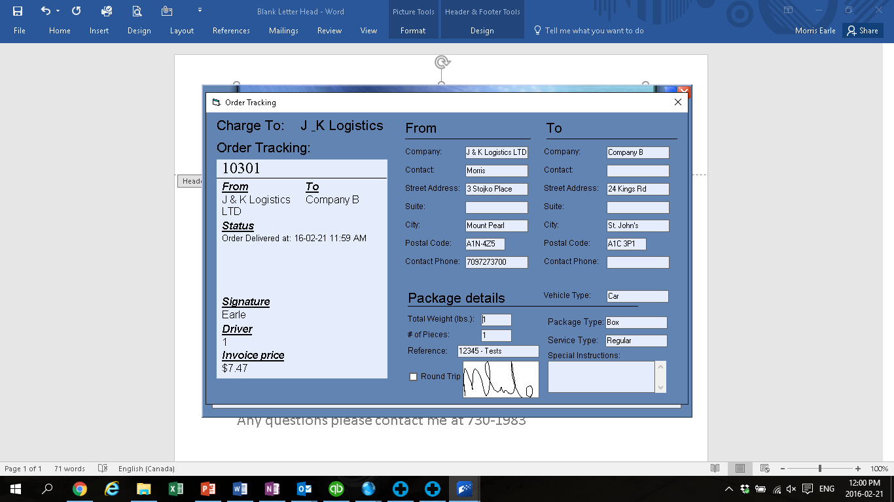
You have the option to have an email sent to you automatically when the shipment is completed.
This information is in real time and will contain all the information regarding your delivery.
You can view shipment information at any time of the day from the history icon.

Slide 5
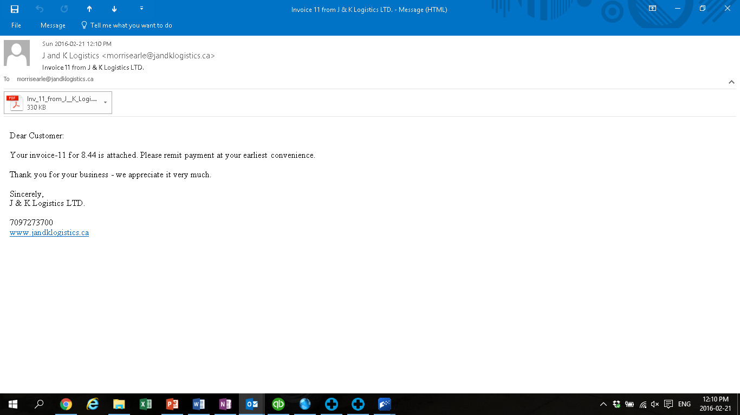
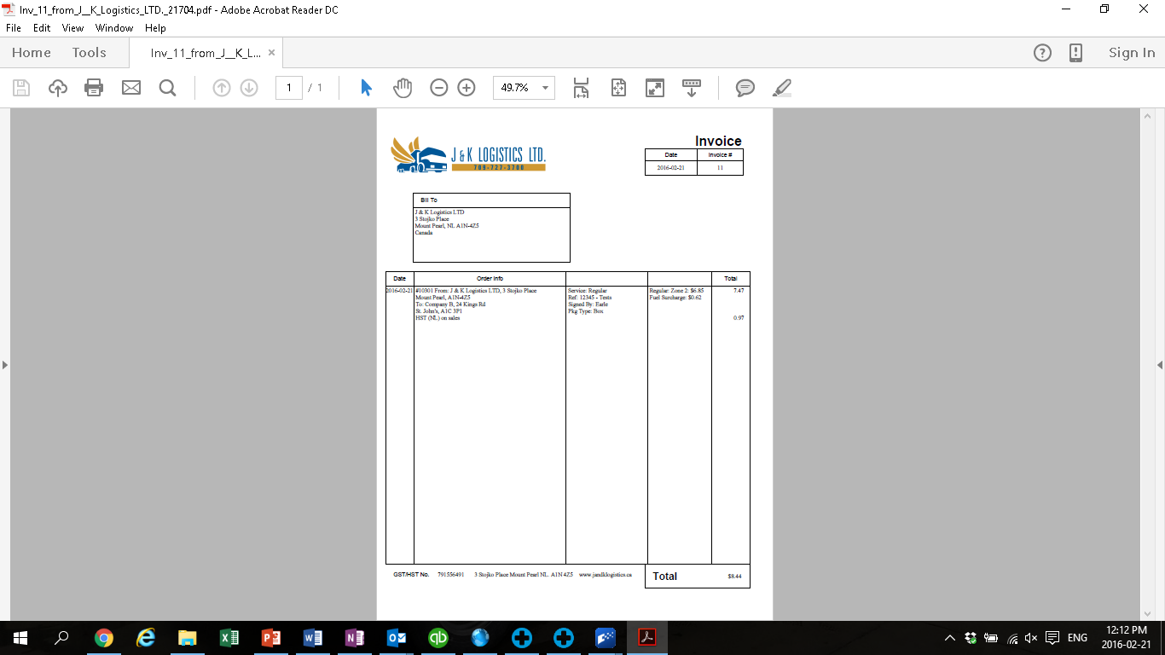
You will receive an email consisting of your invoice.
Print for your records

